Slide 1

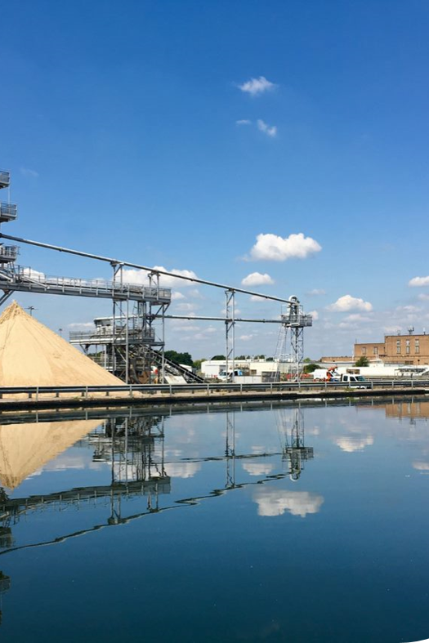
Place this purple overlay over the image on the right.
WATER AND WASTEWATER | UNITED KINGDOM (UK)
Thames Water optimises operations with a standardized modular SCADA approach
Challenge
Isolated SCADA systems to their specific sites
System evolution: over long durations led to varied deployments across the estate.
Products variety: based on “flavor of month” at time of installation.
Data and risk: "Fit and forget" approach leaves unsupported assets and data risks as regulatory compliance demands increase.
Solution
Replacement of various legacy systems in 50+ sites with AVEVA™ System Platform, using a templated, standardized approach, adaptable for systems of different sizes creating consistency across all database construction and visualization.
Results
Standardized SCADA System: drives significant value and potential. Setting us up to be better enabled to meet our executive strategic objectives: Pollutions, Leakages, HSW…
Improved data availability by aligning database structures and increased data access for more business users.
Common Information Model: was introduced, transferable across various business areas.
Notes:
AG

