Slide 1
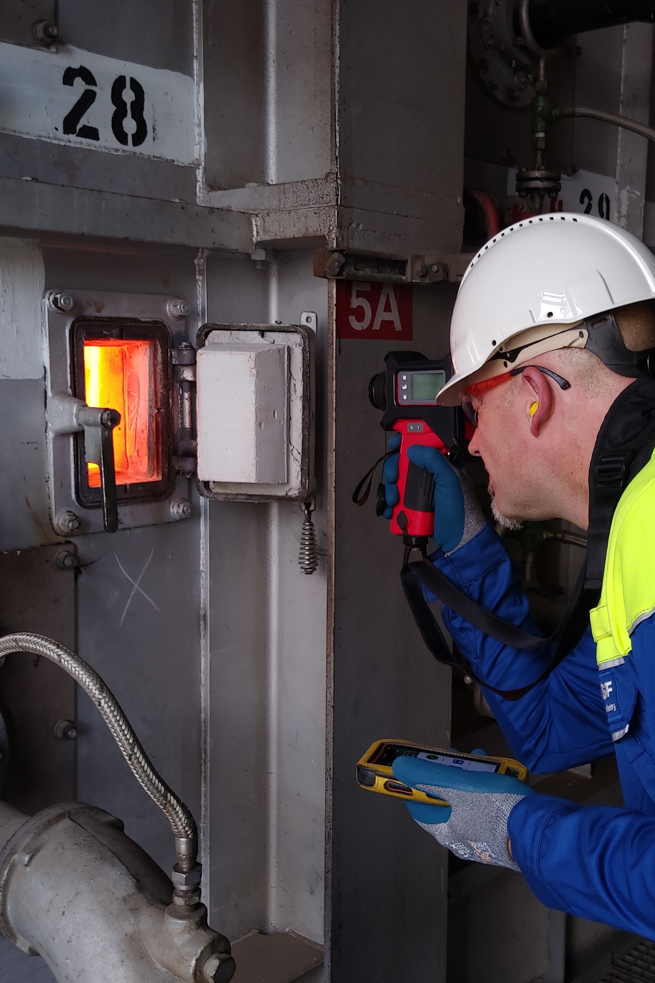

Place this purple overlay over the image on the right.
CHEMICALS | BELGIUM
BASF Antwerp improves production efficiency with Mobile Operator
Challenge
Coke layer builds up in cracking coils, which degrades efficiency
Coils may break, because metal shrinks faster than coke residue
Harsh Environment without fixed measurement instruments
Solution
Bluetooth connection between pyrometer and mobile device
Tube Metal Temperature recorded directly in AVEVA ™Mobile Operator
Results
Less paperwork, more accurate results and 45 minutes saved each day
More than 50,000 records each year, extends overall operation time and prevents downtime or production losses
Learn more
Notes:
Guidelines for completing this summary slide
We are asking all our customer presenters to create a summary slide in this format please. We kindly ask you not to change the format or the text size as we want everyone to be able to see the words.
Slide 2 provides an EXAMPLE of a completed slide.
INDUSTRY – please enter the industry that defines what your business does. Upper case.
LOCATION – please enter the country or region in which the solution is used. Use the term GLOBAL if relevant. Upper case.
HEADING – start with the name of your organisation and use a short sentence to describe the value the solution brings to your business. Use the present tense. Two lines of text max. No full stop (period).
E.g. ABC reduces operating costs and is on-track to be net-zero by 2030
CHALLENGE – outline the challenges you were facing and the manifestation of the pain. Use succinct language. Use the past tense. No full stops (periods).
E.g. Annual storms threatened the stability of the grid, causing power outages for customers and putting repair crews at risk
SOLUTION – summary of the technology, overall solution and approach. Two sentences on three lines max. Include full AVEVA product names.
RESULTS – outline the outcomes in terms of the value delivered to your business. Include metrics if they are available (e.g. % savings, reduction in person-hours, cost savings, % improvements, waste reduction etc.)
Align with the pains outlined in the CHALLENGE section. Include human tangibles also. Begin each point with a past tense verb.
E.g.
Reduced waste by 6%
Cut emissions by 19%
Prevented three plant shutdowns in the first year, saving $millions.
Created a safety-first culture
Increased morale and trust in data

Slide 2
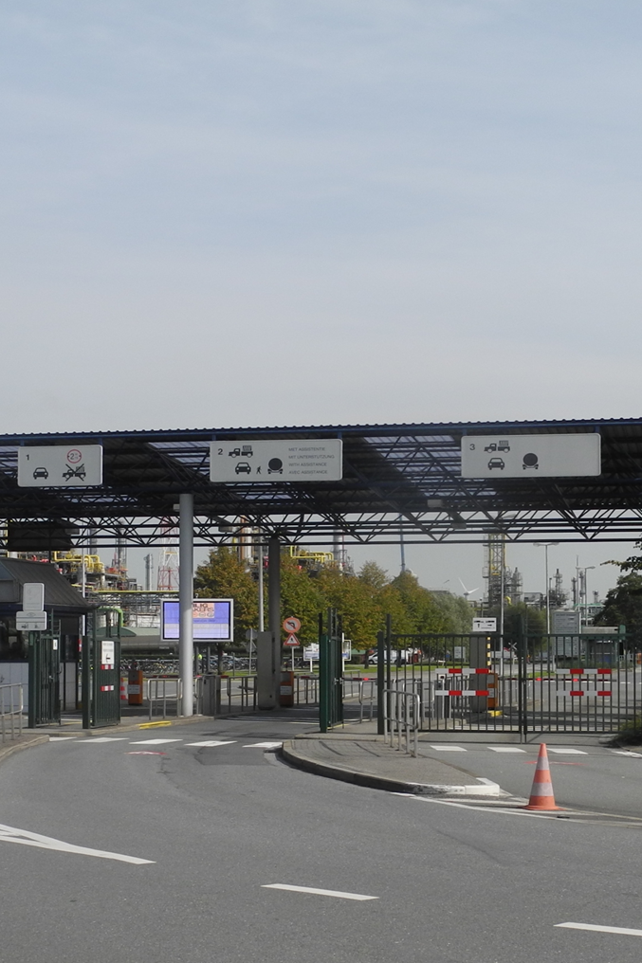

Place this purple overlay over the image on the right.
CHEMICALS | BELGIUM
BASF Antwerp introduced Mobile Operator at Site Security
Challenge
Reusing an existing mobile platform for production rounds in odd use cases like patrols, speed limits, building and luggage checks for theft prevention and information protection
Replace paperwork and digital cameras
Solution
Jobs were scheduled in AVEVA™ Mobile Operator
Dashboard in PowerBI presents job results and planning in the Control Room
Results
Reduced the daily time spend in writing e-mails by exporting data to standard pdf documents
Ability to adjust the strategy, based on results and figures
Only 17 jobs missed out of 12.592 planned jobs in 2023, 99,86% completed on time
Learn more
Notes:
Guidelines for completing this summary slide
We are asking all our customer presenters to create a summary slide in this format please. We kindly ask you not to change the format or the text size as we want everyone to be able to see the words.
Slide 2 provides an EXAMPLE of a completed slide.
INDUSTRY – please enter the industry that defines what your business does. Upper case.
LOCATION – please enter the country or region in which the solution is used. Use the term GLOBAL if relevant. Upper case.
HEADING – start with the name of your organisation and use a short sentence to describe the value the solution brings to your business. Use the present tense. Two lines of text max. No full stop (period).
E.g. ABC reduces operating costs and is on-track to be net-zero by 2030
CHALLENGE – outline the challenges you were facing and the manifestation of the pain. Use succinct language. Use the past tense. No full stops (periods).
E.g. Annual storms threatened the stability of the grid, causing power outages for customers and putting repair crews at risk
SOLUTION – summary of the technology, overall solution and approach. Two sentences on three lines max. Include full AVEVA product names.
RESULTS – outline the outcomes in terms of the value delivered to your business. Include metrics if they are available (e.g. % savings, reduction in person-hours, cost savings, % improvements, waste reduction etc.)
Align with the pains outlined in the CHALLENGE section. Include human tangibles also. Begin each point with a past tense verb.
E.g.
Reduced waste by 6%
Cut emissions by 19%
Prevented three plant shutdowns in the first year, saving $millions.
Created a safety-first culture
Increased morale and trust in data

Slide 3
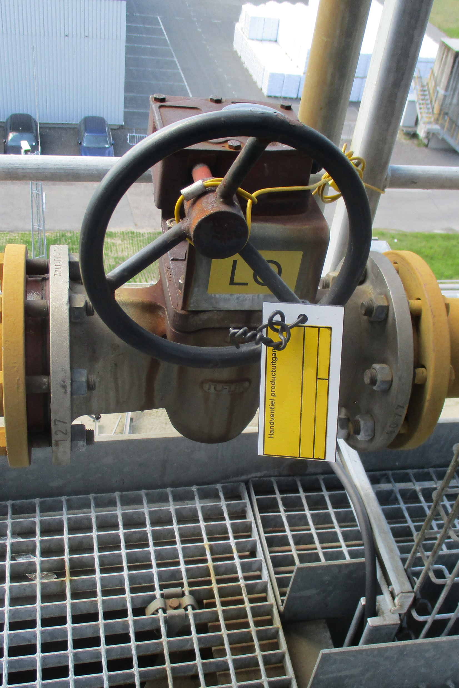
Place this purple overlay over the image on the right.
CHEMICALS | BELGIUM
BASF Antwerp eliminates spreadsheets and paperwork for periodic checks
Challenge
Standardization of site wide periodic checks, eliminating spreadsheets and paperwork, to a fully digital system, where everything can be tracked
Integration of existing systems at each plant in one application
Solution
Deployed AVEVA™ Work Tasks for periodic checks
Results
17,000 checks already completed on a variety of assets
Efficient workflow for the operator and easy follow up
Scalable solution that covers a wide range of assets
Learn more
Notes:
Guidelines for completing this summary slide
We are asking all our customer presenters to create a summary slide in this format please. We kindly ask you not to change the format or the text size as we want everyone to be able to see the words.
Slide 2 provides an EXAMPLE of a completed slide.
INDUSTRY – please enter the industry that defines what your business does. Upper case.
LOCATION – please enter the country or region in which the solution is used. Use the term GLOBAL if relevant. Upper case.
HEADING – start with the name of your organisation and use a short sentence to describe the value the solution brings to your business. Use the present tense. Two lines of text max. No full stop (period).
E.g. ABC reduces operating costs and is on-track to be net-zero by 2030
CHALLENGE – outline the challenges you were facing and the manifestation of the pain. Use succinct language. Use the past tense. No full stops (periods).
E.g. Annual storms threatened the stability of the grid, causing power outages for customers and putting repair crews at risk
SOLUTION – summary of the technology, overall solution and approach. Two sentences on three lines max. Include full AVEVA product names.
RESULTS – outline the outcomes in terms of the value delivered to your business. Include metrics if they are available (e.g. % savings, reduction in person-hours, cost savings, % improvements, waste reduction etc.)
Align with the pains outlined in the CHALLENGE section. Include human tangibles also. Begin each point with a past tense verb.
E.g.
Reduced waste by 6%
Cut emissions by 19%
Prevented three plant shutdowns in the first year, saving $millions.
Created a safety-first culture
Increased morale and trust in data

